Slide 1

GRAMMAR AUTO-CORRECT
DOMAIN: AI/ML
MENTOR: Anushka Vashney
TEAM MEMEBERS:
Shreeyut Maheswari
Srikanth Chebolu
Piyush Tiwari
Vikash Kumar Singh

Slide 2
PROBLEM STATEMENT
Given an input paragraph, detect the grammatical inconsistencies in it and rectify them. Bonus: Add suggestions to improve vocabulary and tone improvements by understanding context.

Slide 3








PROJECT TIMELINE
WEEK: 1-2
WEEK: 3-4
WEEK: 5-6
WEEK: 7
Learnt neccesary tech-stacks.
DATASET FINDING AND EXPLORATION
WORKING ON MODIFICATIONS
Deploy Gradio Website.

Slide 4


DATASET FINDING AND TRAINING
Firstly, we researched various hugging face transformers and read various research papers on grammar auto- correct to generate precise corrected sentence. In our process we tried ﬁne-tuning various hugging face models. After checking Metrics like Accuracy Score , analysing the quality of results, we chose grammarly coedit dataset for grammar related task and for ﬁnding the error in the sentences. We created our custom dataset with help of ai, we created of csv ﬁle and both the models were ﬁne-tuned on t5-small transformer.

Slide 5

EXPLORATION
First we learn basic machine learning algorithms and libraries, then we studied about transformers, nlp, hugging face, then we tried various models, some of which were transformers trained from scratch on datasets related for the work and also tried using models directly from hugging face using pipeline which were already ﬁne- tuned for the related work.

Slide 6
WHY GRAMMARLY COEDIT DATASET IS CHOOSEN?
First we tried using datasets from kaggle but they did not contain large data and were not giving expected output. Then we used datasets CoNLL-2014, lesyarun c4 200m gec, liweli c4 200m, train 100k test 25k, jﬂeg, but we didn't choose this because ram was crashing while training them. Plus, this grammarly coedit dataset contained other task also like neutralization, simpliﬁcation, paraphrasing the text.

Slide 7
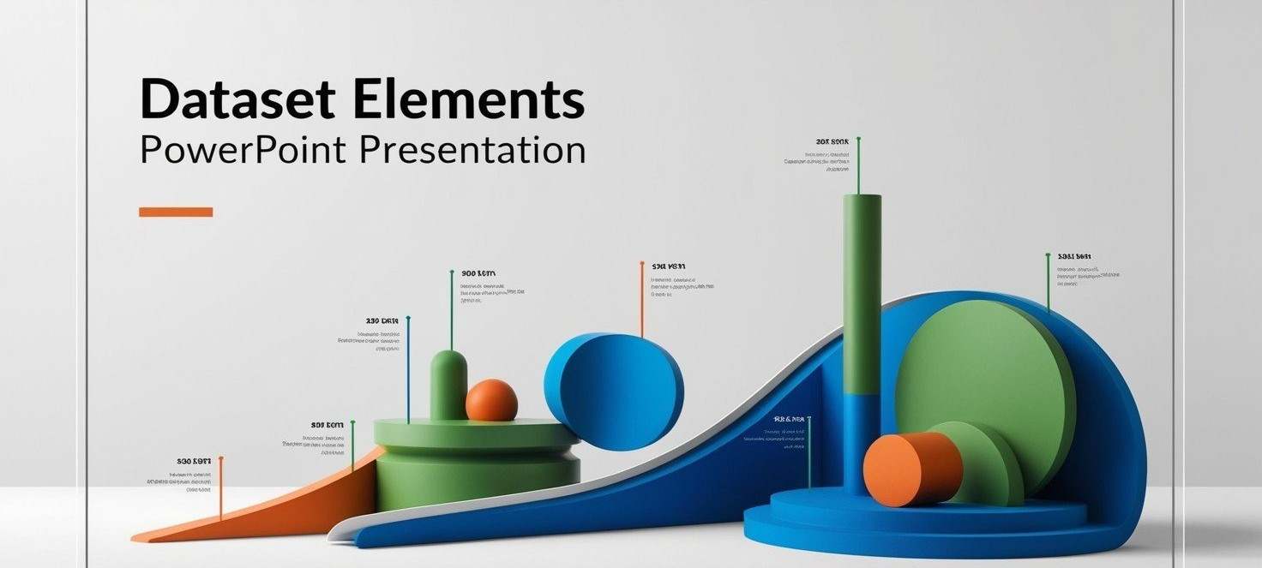
HOW CUSTOM DATASET WAS MADE
The sentences were searched from various english books, There were exercise regarding ﬁnding the grammatical error in the sentences and then it was made into csv ﬁle and then used for training purposes.

Slide 8

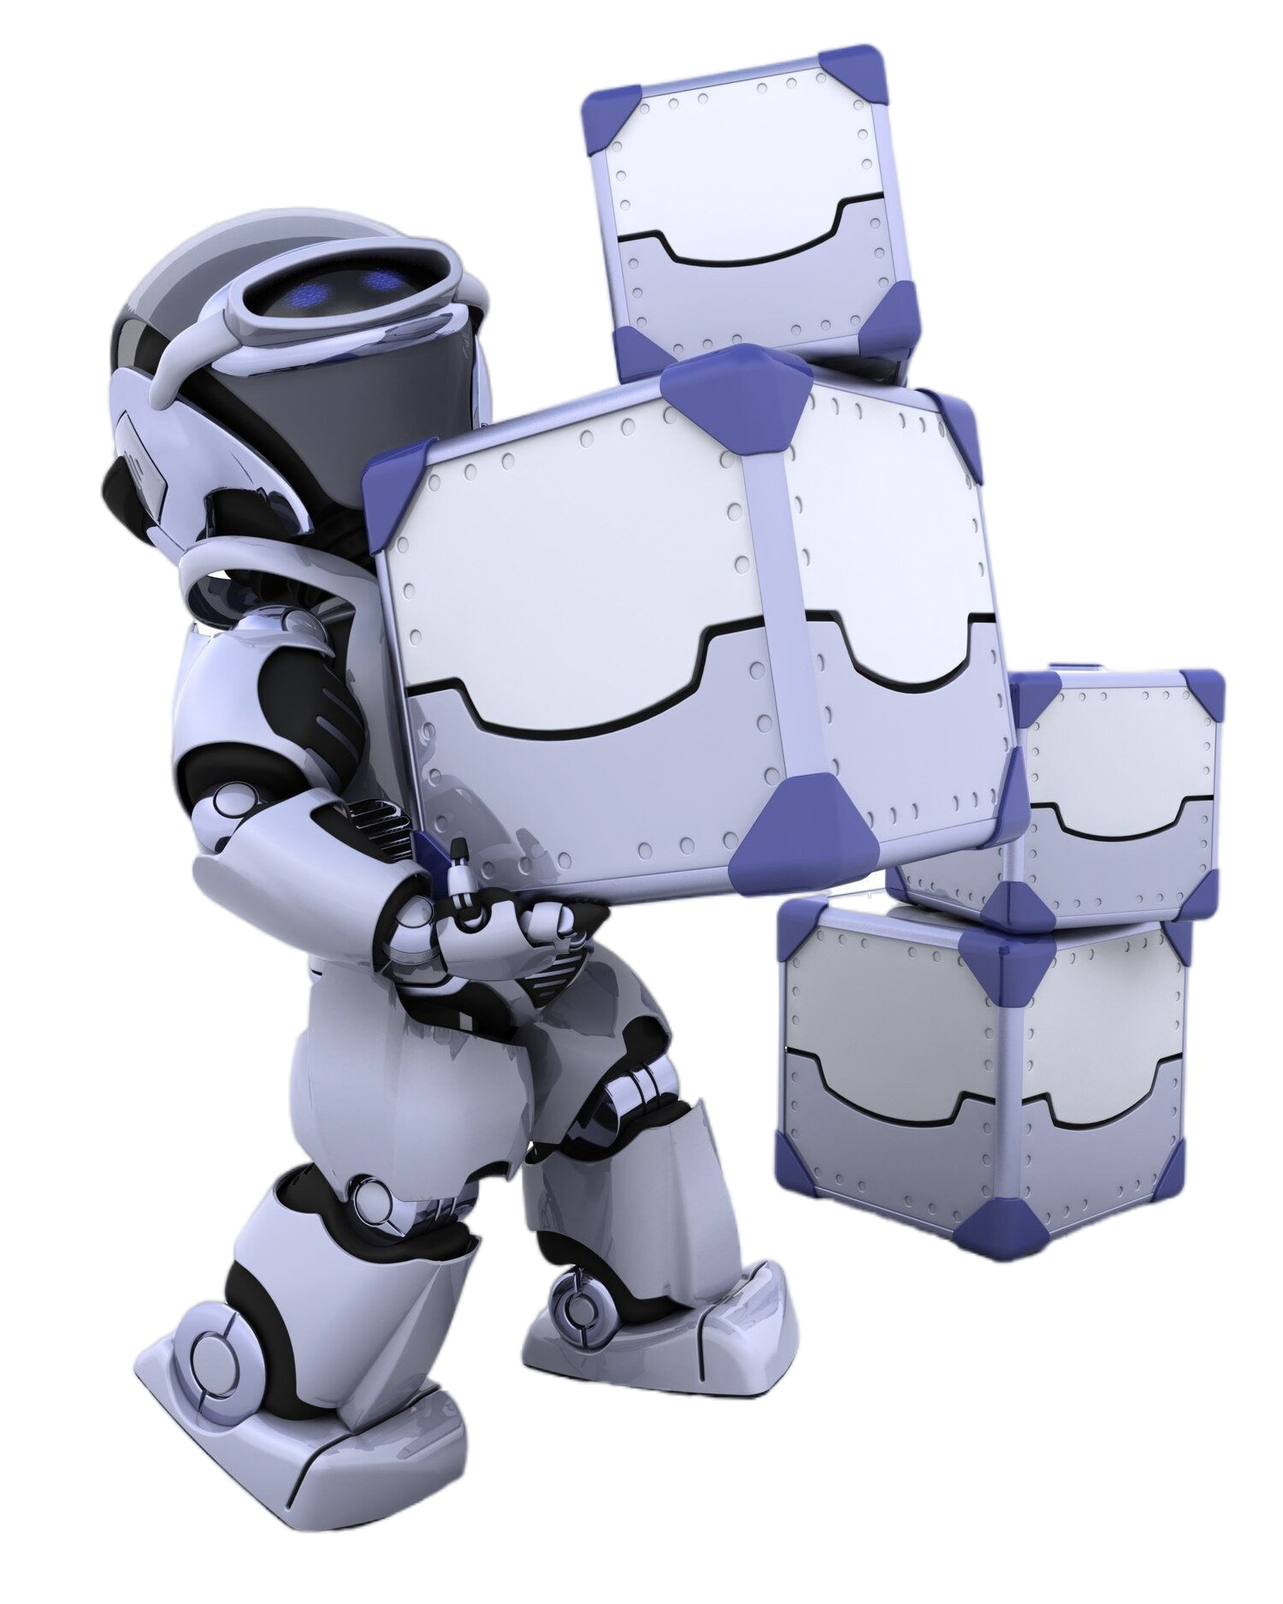
FINE- TUNING
For ﬁne-tuning the coedit dataset was directly imported from hugging face , then data was preprocessed and padded. Then the tokenizer and model was imported from hugging face library and after ﬁne-tuning, the model was saved, for using it for future purposes.

Slide 9
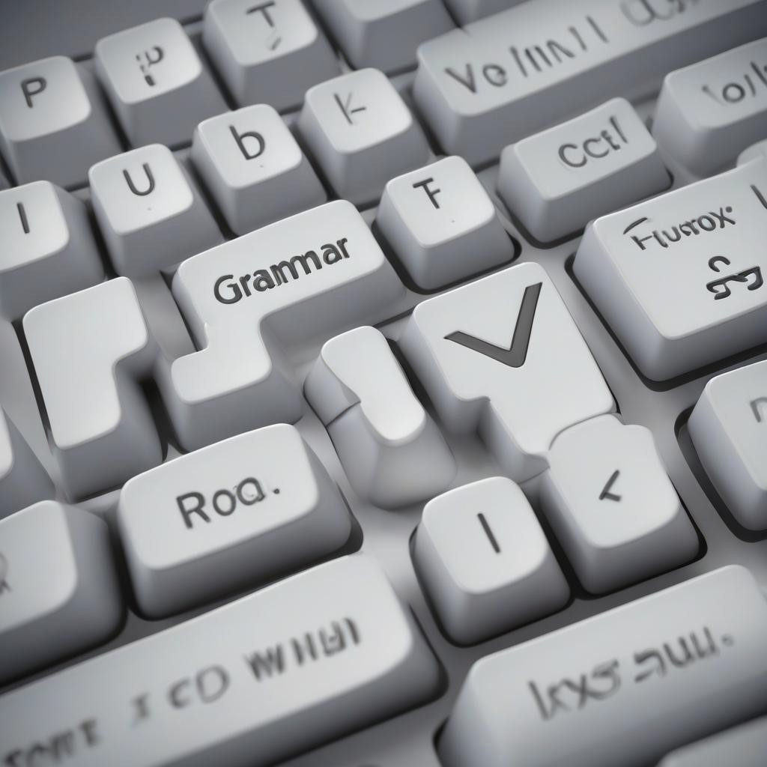
WORKING ON MODIFICATINS
The t5 small model was ﬁne-tuned on the following parameters like standard learning rate was set and we adjusted batch size to process multiple inputs and improve efﬁcency. We adjusted the weight decay to avoid overﬁtting. Then saved to output directory named results.

Slide 10
RESULTS for the results Transformer
TOTAL TRAINING TIME: 2 HOURS
EPOCH | TRAINING LOSS | VALIDATION LOSS
1. | 0.1686 | 0.245516
2. | 0.1583 | 0.234669
3. | 0.1556 | 0.232516

Slide 11
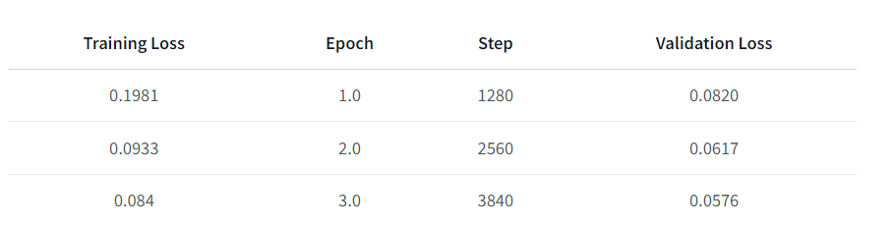
RESULTS for the gennnie Transformer
link to this model

Slide 12
CREATING THE FINAL CODE
The ﬁne-tuned model was reused on google collab with the help of hugging face and then the ﬁnal code was prepared in which text and audio input was added and the model was returning precise and concise results.

Slide 13

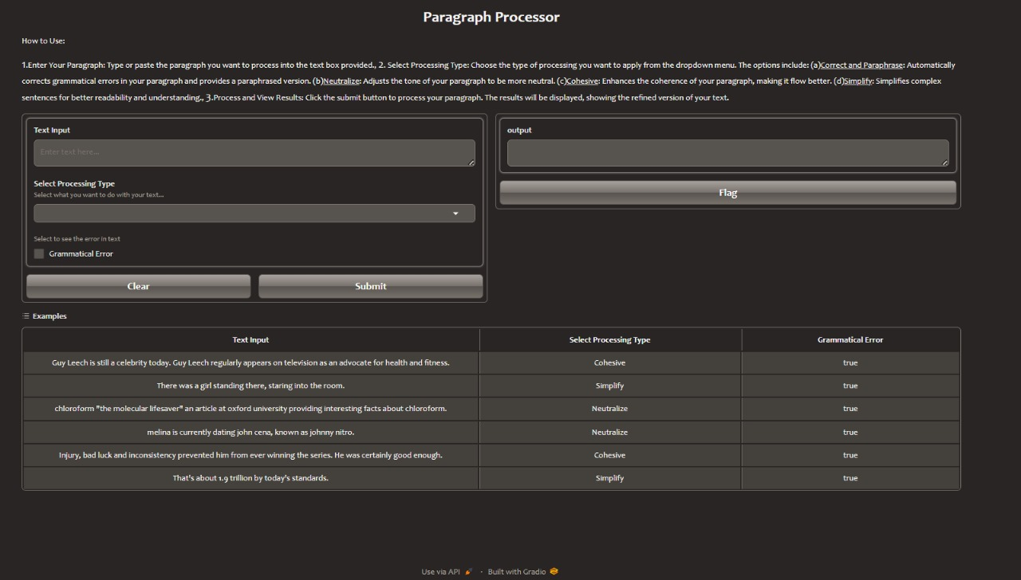
Deploy Gradio Website
We deployed our model through gradio it takes text and audio input and gives fast and precise results.

Slide 14

Conclusion
1.Error Detection: Identiﬁes various types of
grammatical errors such as punctuation mistakes,
subject-verb agreement issues, incorrect word usage, etc
Performance: Achieves high accuracy in error detection and correction through pre-trained ﬁne- tuning.
Modiﬁcations: Paraphrase text, Improved grammar text, Simpliﬁed text, Cohesivetext, and Neutralized text.

Slide 15
Thanks!

